Slide 1
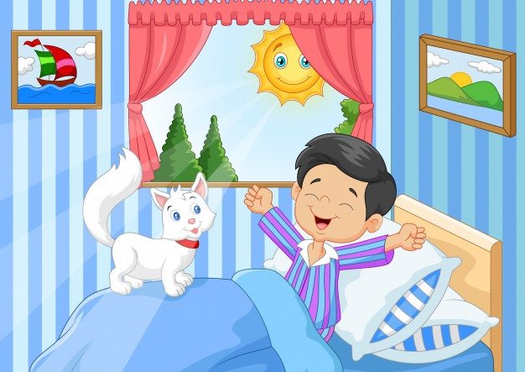

HOW DO YOU FEEL?
APRIL
2020
COMO TE SIENTES?

Slide 2

HEALTH PROBLEMS
How are you?
How are you today?
How do you feel?
How do you feel today?

Slide 3
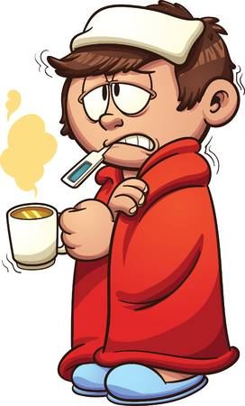
How are you today?
I’m sick
I feel sick
Not so good
Not very good

Slide 4
HOW ARE YOU TODAY?
To say How you are, you can use:
I feel + an adjective
Example: I feel fine
 | I feel …
Fine |  | Sick
Good |  | Awful
Great |  | Terrible
Fantastic |  | Miserable

Slide 5
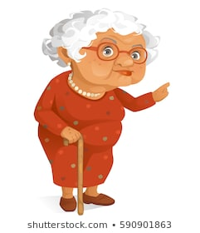
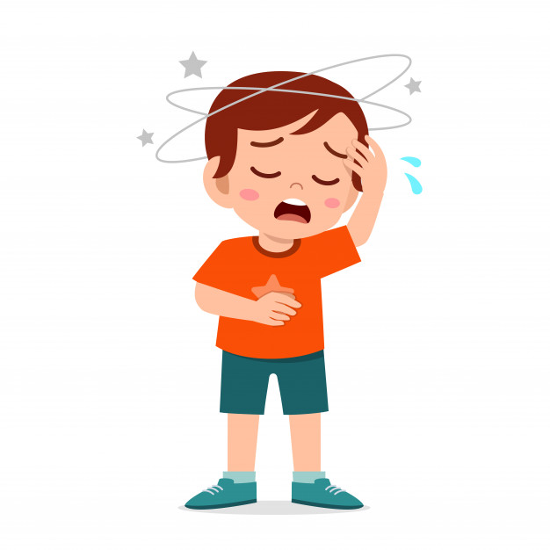
How do you feel today?
Not so good
What’s the problem?
I have a headache
I’m sorry to hear that

Slide 6
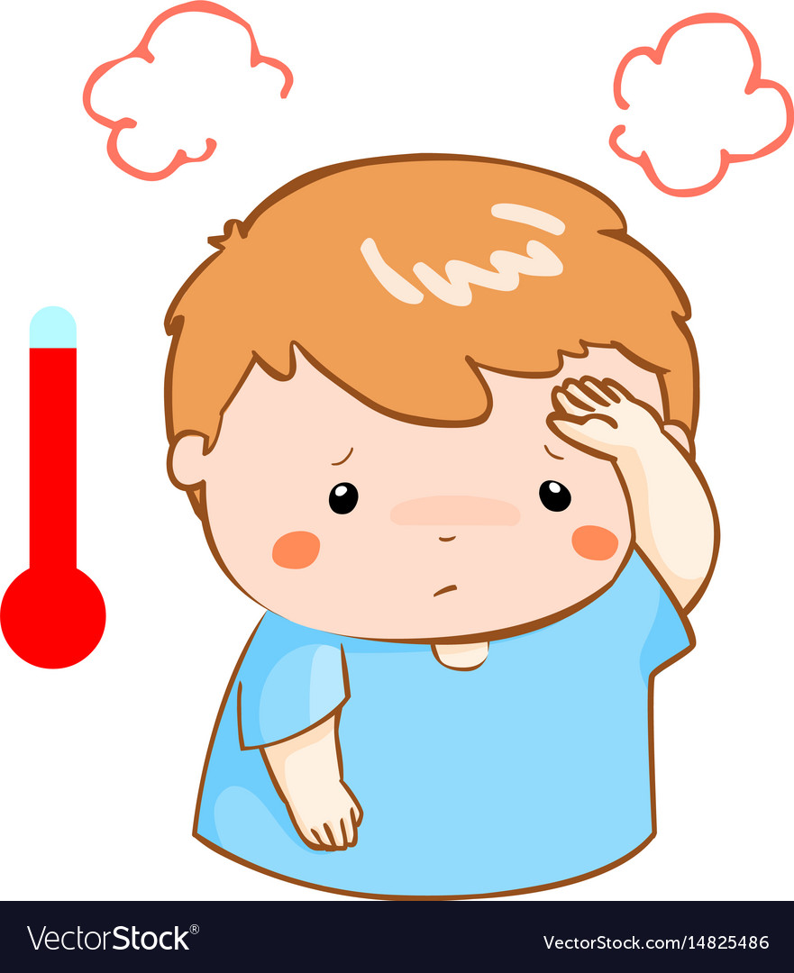
FEVER

Slide 7
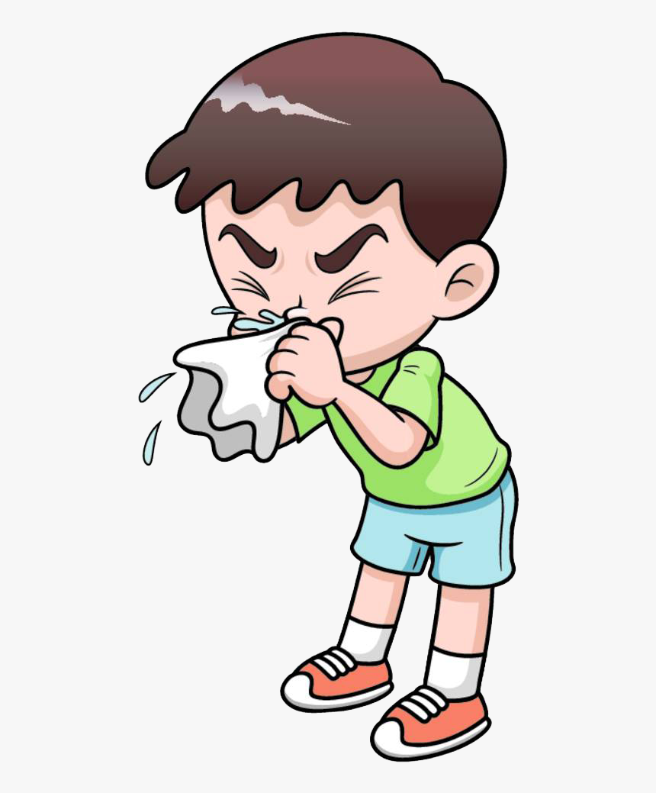
COLD

Slide 8
HEADACHE

Slide 9
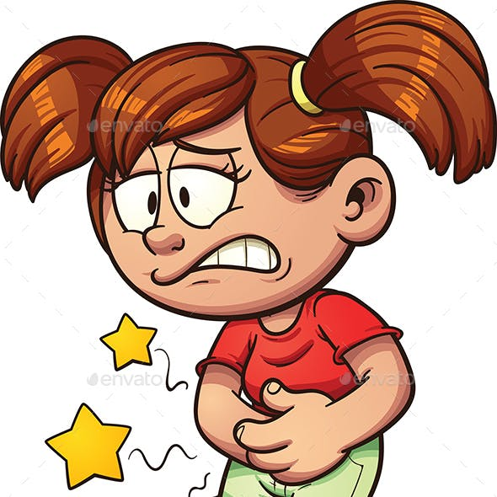
STOMACHACHE

Slide 10
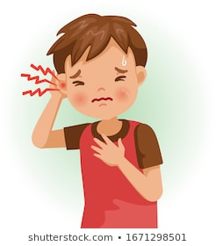
EARACHE

Slide 11
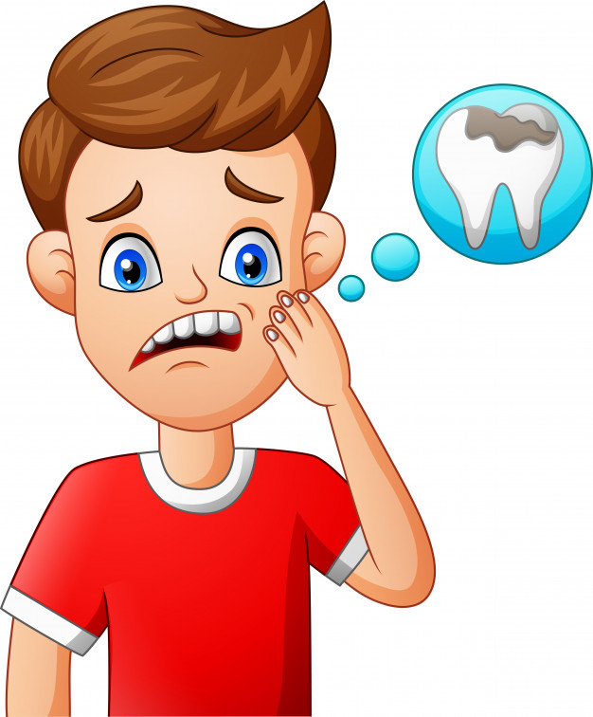
TOOTHACHE

Slide 12
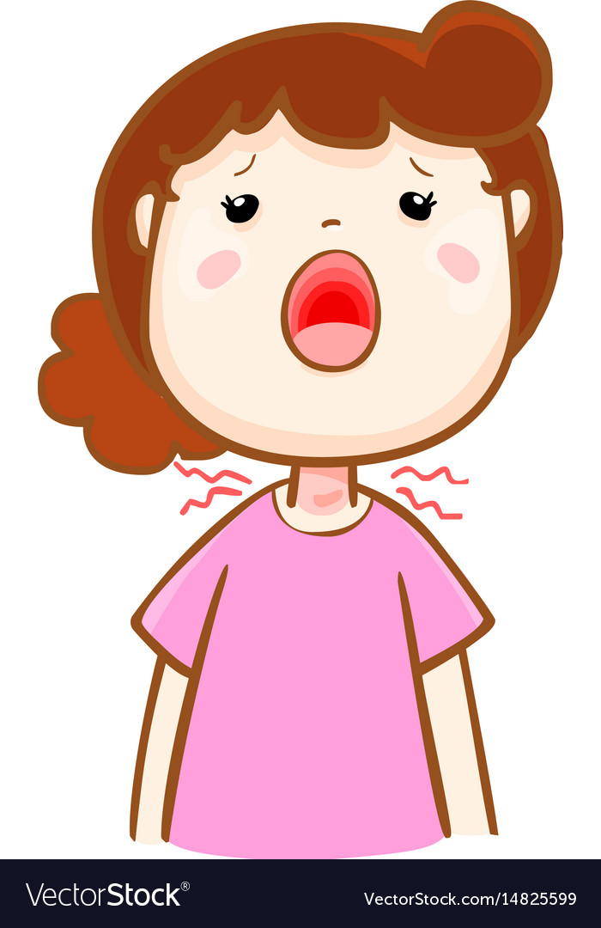
SORE THROAT

Slide 13

DOCTOR

Slide 14
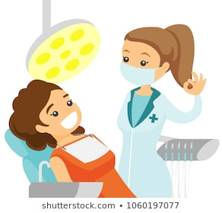
DENTIST

Slide 15

HOSPITAL

Slide 16
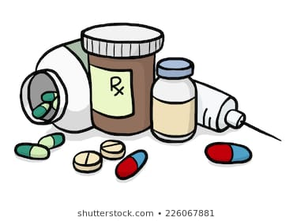
MEDICINE

Slide 17


Slide 18
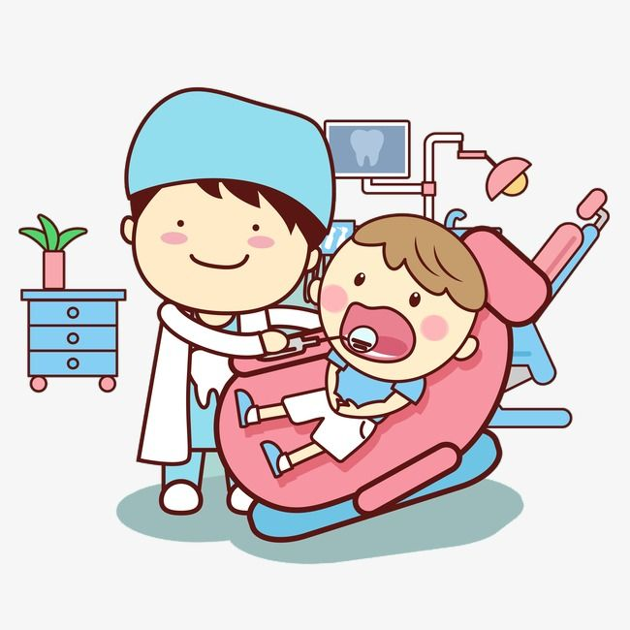
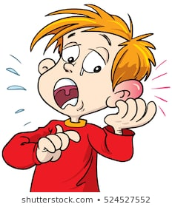
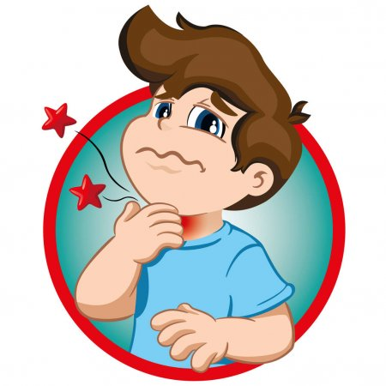
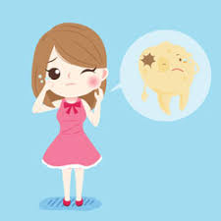
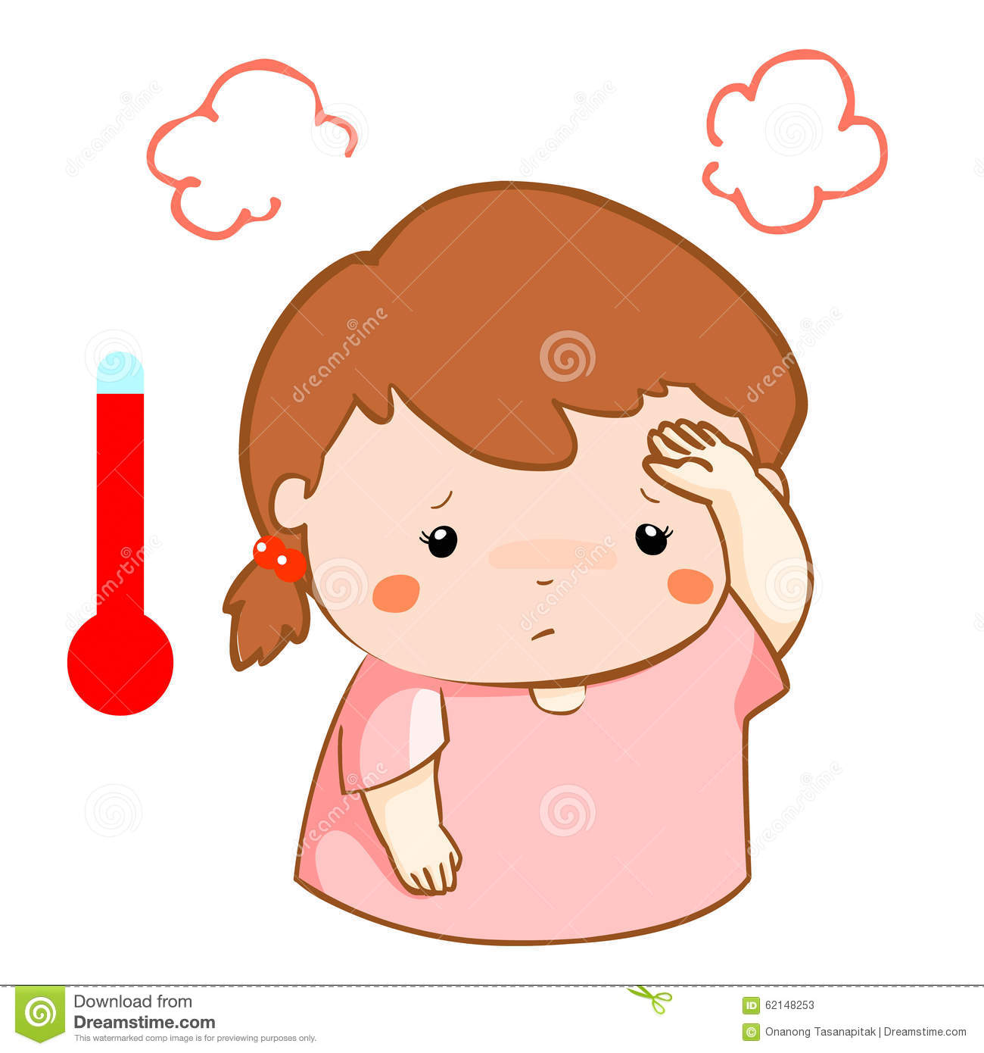
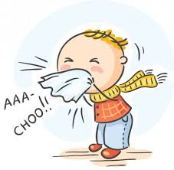
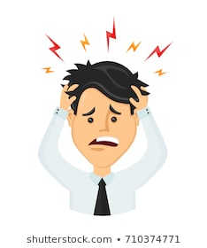

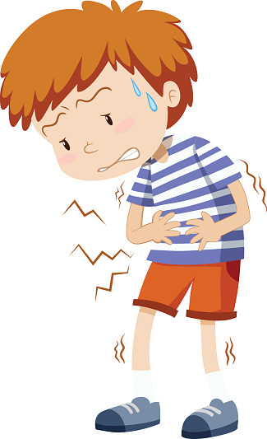
Matching. Look at the words in the list below and write them under the correct pictures.
(Mira las palabras en el recuadro y escríbelas debajo de las imágenes según corresponda.)
Fever Cold Headache Medicine Doctor Stomachache
Sorethroat Earache Toothache Dentist

Slide 19

Thank You!
Miss. Daniela Moreno C.
Daniela.moreno@elar.cl

